Slide 1
Configuration, Routing, Models, Views

Slide 2
Table of Contents
ASP.NET Core Configuration
Routing
Controllers and Actions
Models and Attributes
Views

Slide 3
ASP.NET Core Configuration

Slide 4
ASP.NET Core Configuration
In the Startup class, there are two methods where most of our work will take place. The Configure method of the class is where you build your HTTP processing pipeline.
This defines how your application responds to requests.
For example, if we want to serve the static files such as an index.html file, we will need to add some code to the Configure method.
You can also have an error page or route requests to an ASP.NET MVC controller; both of these scenarios will also require to do some work in this Configure method.
In the Startup class, you will also see the ConfigureServices() method. This helps you configure components for your application.

Slide 5
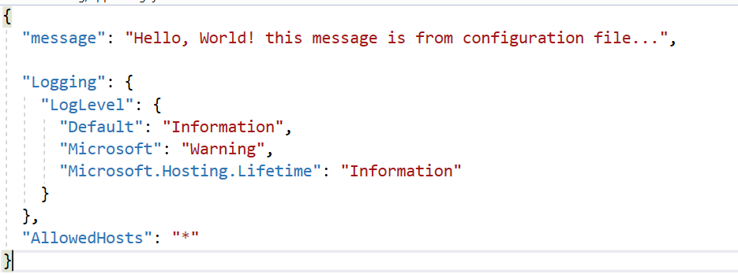
appsettings.json
Typical configuration file

Slide 6
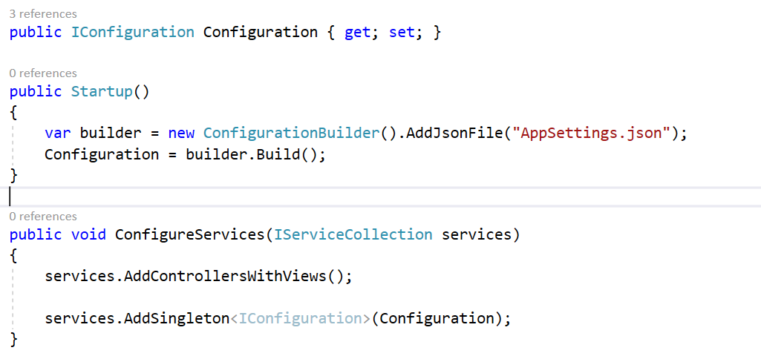
Reading configuration settings

Slide 7
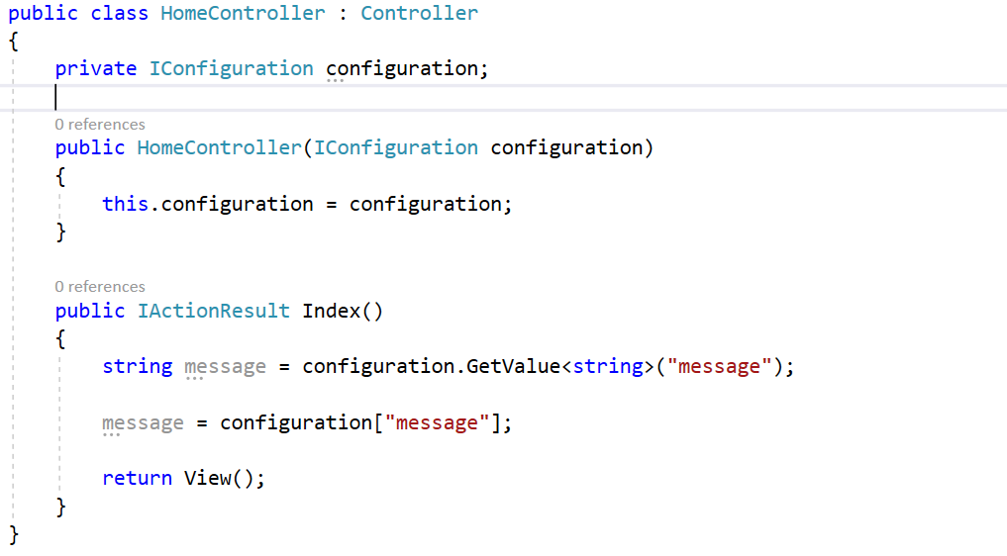
Using configuration in controller

Slide 8
ASP.NET Core Routing

Slide 9
ASP.NET Core Routing
In MVC framework, we have three components, each with its own focus on a specific part of the job.
In order for all of this to work, we need to find a way to send these HTTP requests to the right controller.
In ASP.NET Core MVC, this process is known as routing.
Routing is the process of directing an HTTP request to a controller.

Slide 10
ASP.NET Core Routing
Let us now understand how to route requests to different controllers.
The ASP.NET Core middleware needs a way to determine if a given HTTP request should go to a controller for processing or not.
The MVC middleware will make this decision based on the URL and some configuration information we provide. In this chapter, we will define this configuration information or you can say routing information inside Startup.cs when we add the MVC middleware.
This approach is often referred to as the convention-based routing. The following is a code snippet for conventional routing.

Slide 11
ASP.NET Core Routing
In this approach, we define templates that tell MVC how to look at a URL and find a controller name and an action name where a controller is a C# class and an action is a public method on that class.

Slide 12
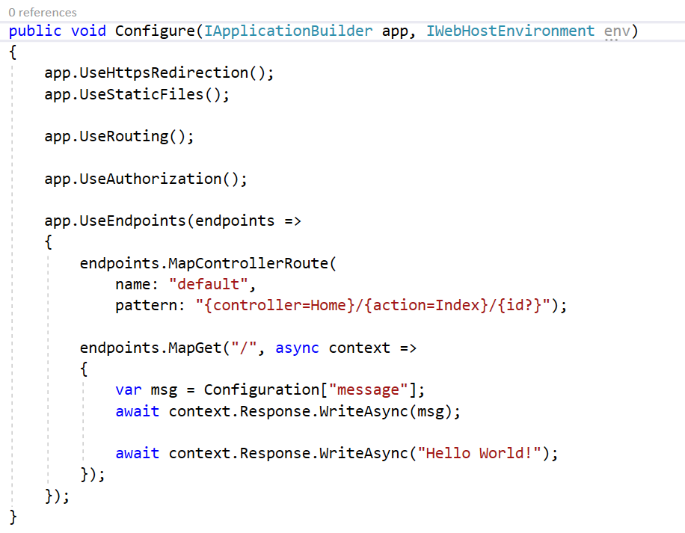
ASP.NET Core Routing

Slide 13
ASP.NET Core - Attribute Routes
With attribute-based routing, we can use C# attributes on our controller classes and on the methods internally in these classes. These attributes have metadata that tell ASP.NET Core when to call a specific controller.
It is an alternative to convention-based routing.
Routes are evaluated in the order that they appear, the order that you register them in, but it's quite common to map multiple routes particularly if you want to have different parameters in the URL or if you want to have different literals in the URL.

Slide 14
ASP.NET Core - Attribute Routes
Let us take a simple example. Open the FirstAppDemo project and run the application in the browser.
What we want here is that when we specify /about, the application should invoke the Phone action of the AboutController. Here, we can enforce some explicit routes for this controller using a Route attribute. This attribute is in the namespace Microsoft.AspNet.Mvc.
The following is the implementation of AboutController in which the attribute routes are added.

Slide 15
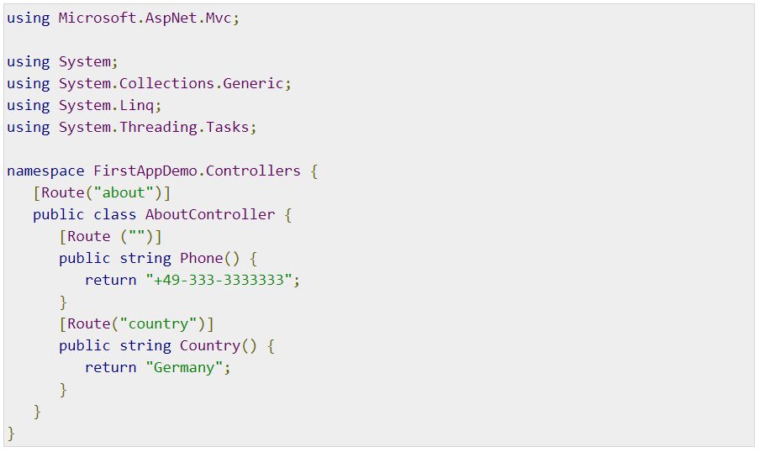
ASP.NET Core - Attribute Routes

Slide 16
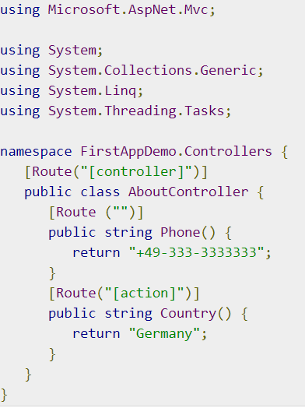
ASP.NET Core - Attribute Routes
If you want a segment of the URL to contain the name of your controller, what you can do is instead of using the controller name explicitly, you can use a token controller inside the square brackets. This tells ASP.NET MVC to use the name of this controller in this position as shown in the following program.
https://www.tutorialspoint.com/asp.net_core/asp.net_core_attribute_routes.htm

Slide 17
Routing and configuration
Life demo

Slide 18
Controllers and Actions

Slide 19
Controller and Controller base class
In the previous chapters, we have been using plain simple C# classes as controllers. These classes don't derive from a base class, and you can use this approach with MVC, but it is more common to derive a controller from a controller base class provided in the Microsoft.AspNet.Mvc namespace.
This base class gives us access to lots of contextual information about a request, as well as methods that help us build results to send back to the client.
You can send back simple strings and integers in a response. You can also send back complex objects like an object to represent a student or university or restaurant etc. and all the data associated with that object.
These results are typically encapsulated into an object that implements the IActionResult interface.
There are many different result types that implement this interface — result types that can contain models or the contents of a file for download.
These different result types can allow us to send back JSON to a client or XML or a view that builds HTML.

Slide 20
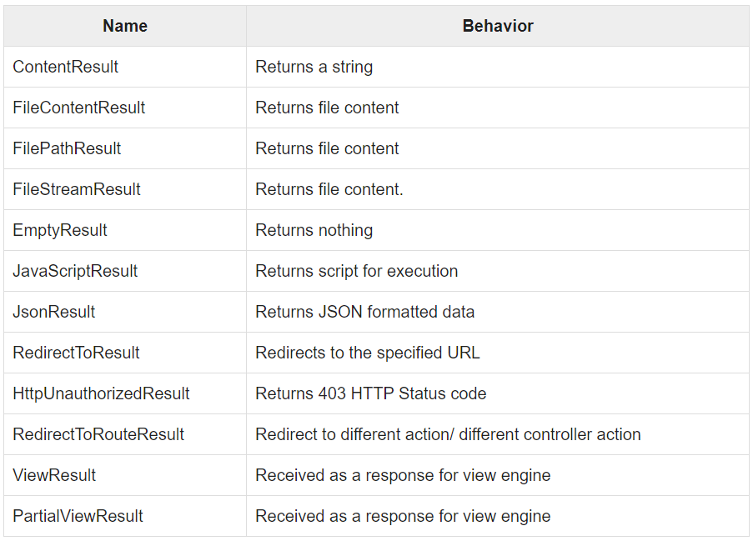
Actions
Actions basically return different types of Action Results. The ActionResult class is the base for all the action results. The following is a list of different kind of action results and their behavior.

Slide 21
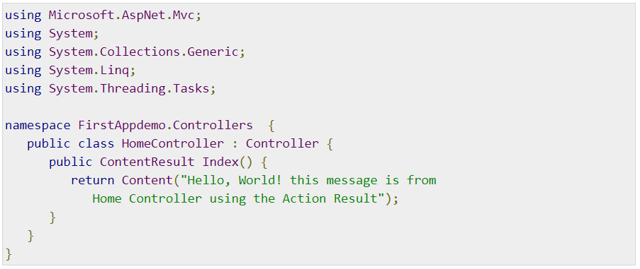
Actions
Let us perform a simple example by opening the HomeController class and derive it from the controller based class. This base class is in the Microsoft.AspNet.Mvc namespace. The following is the implementation of the HomeController class.
You can now see that the index method is returning the ContentResult which is one of the result types and all these result types implement ultimately an interface, which is the ActionResult.
In the Index method, we have passed a string into the Content method. This Content method produces a ContentResult; this means the Index method will now return ContentResult.

Slide 22
ActionResult
You can now see a response which doesn’t look any different from the response we had before. It is still just going to be a plain text response.
You might be wondering what is the advantage of using something that produces an ActionResult.
The typical advantage is that it is just a formal way to encapsulate the decision of the controller.
The controller decides what to do next, either return a string or HTML or return a model object that might be serialized into JSON etc.
All that the controller needs to do is make that decision and the controller does not have to write directly into the response the results of its decision.
It just needs to return the decision and then it is the framework that will take a result and understand how to transform that result into something that can be sent back over HTTP.

Slide 23
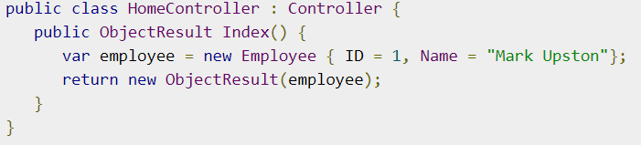
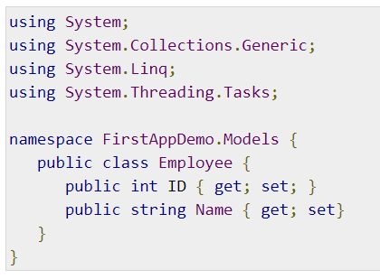
Action results
Live demo

Slide 24
View Models

Slide 25
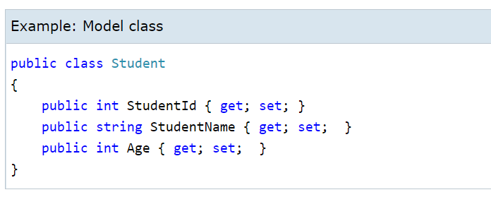
View Models
The model classes represents domain-specific data and business logic in the MVC application. It represents the shape of the data as public properties and business logic as methods.
In the ASP.NET MVC Application, all the Model classes must be created in the Model folder.

Slide 26
Views

Slide 27
Views
In an ASP.NET Core MVC application, there is nothing like a page and it also doesn’t include anything that directly corresponds to a page when you specify a path in the URL. The closest thing to a page in an ASP.NET Core MVC application is known as a view.
As you know that in ASP.NET MVC application, all incoming browser requests are handled by the controller and these requests are mapped to the controller actions.
A controller action might return a view or it might also perform some other type of action such as redirecting to another controller action.
With the MVC framework, the most popular method for creating HTML is to use the Razor view engine of ASP.NET MVC.
To use this view engine, a controller action produces a ViewResult object, and a ViewResult can carry the name of the Razor view that we want to use.

Slide 28
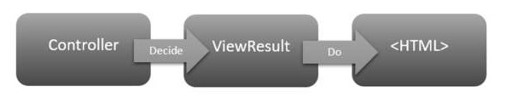
Views
The view will be a file on the file system and the ViewResult can also carry along a model object to the view and the view can use this model object when it creates the HTML.
When the MVC framework sees that your controller action produces a ViewResult, the framework will find the view on the file system, execute the view, which produces HTML, and it is this HTML which the framework sends back to the client.

Slide 29
Integrate Controller, Model and View
Live demo
https://www.tutorialsteacher.com/mvc/integrate-controller-view-model

Slide 30
Views
Live demo
https://www.tutorialspoint.com/asp.net_core/asp.net_core_views.htm

Slide 31
HTML Helpers
https://www.tutorialsteacher.com/mvc/html-helpers

Slide 32
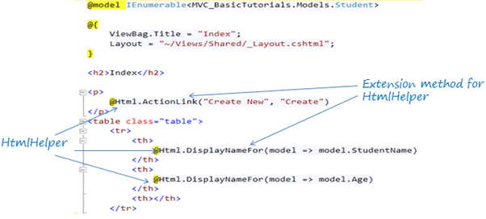
HTML Helpers
The HtmlHelper class renders HTML controls in the razor view. It binds the model object to HTML controls to display the value of model properties into those controls and also assigns the value of the controls to the model properties while submitting a web form. So always use the HtmlHelper class in razor view instead of writing HTML tags manually.
The following figure shows the use of the HtmlHelper class in the razor view.

Slide 33
HTML Helpers
In the above figure, @Html is an object of the HtmlHelper class. (@ symbol is used to access server-side object in razor syntax). Html is a property of the HtmlHelper class included in base class of razor view WebViewPage. The ActionLink() and DisplayNameFor() are extension methods included in the HtmlHelper class.
The HtmlHelper class generates HTML elements.
For example, @Html.ActionLink("Create New", "Create") would generate anchor tag
<a href="/Student/Create">Create New</a>.
There are many extension methods for HtmlHelper class, which creates different HTML controls.

Slide 34
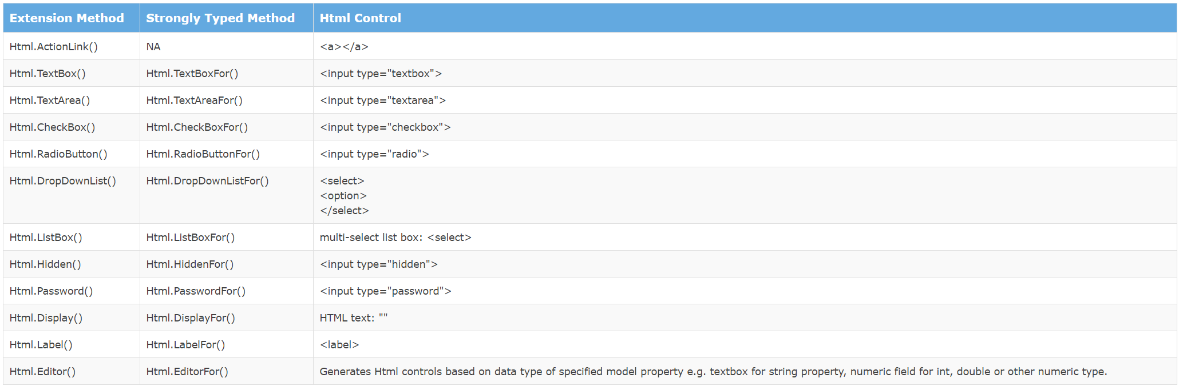
HTML Helpers
The following table lists the HtmlHelper methods and HTML control each method renders.

Slide 35
References
https://www.tutorialspoint.com/asp.net_core/asp.net_core_configuration.htm
https://www.tutorialsteacher.com/core
https://www.tutorialsteacher.com/ioc
https://www.tutorialspoint.com/asp.net_core/index.htm
https://docs.microsoft.com/en-us/aspnet/core/tutorials/first-mvc-app/start-mvc
https://docs.microsoft.com/en-us/aspnet/core/fundamentals/logging

Slide 36
Homework – Students
Create new ASP.NET Core MVC web project using the default template
Title of the web site to be taken from appsettings.json config file
Add StudentsService
Add private property StudentsList, containing list of students 5-10 records and each student should have FirstName, LastName, StudentNumber
Add appropriate methods needed to serve the students controller
Create Students controller and appropriate view models and views
Create following pages
/students/list – to display list of all students
/students/list?fn=X&ln=Y – to display list of students with first name=X or last name=Y
/students/details/SN – to display details of specific student by student number

